Slide 1
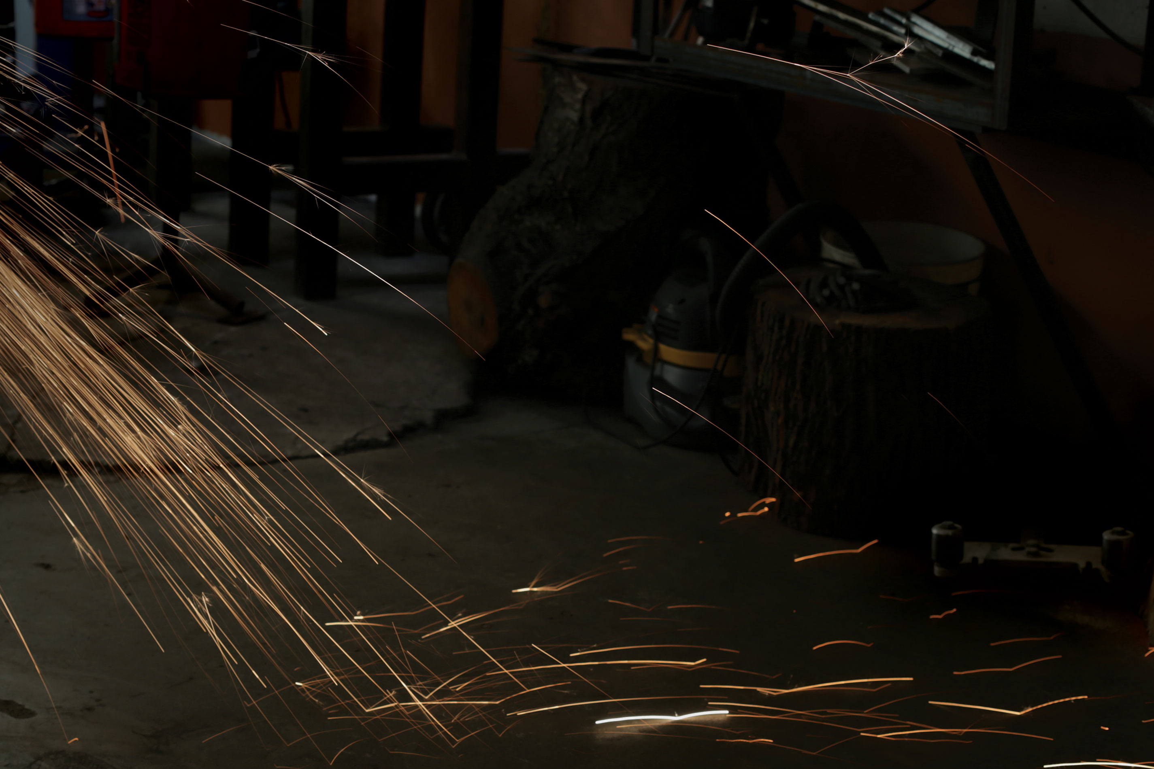
IERG foundry10 Imagination, gender and their importance in perceived choices
www.foundry10.org
@foundry10ed

Slide 2


Who we are
Lisa Castaneda, M.ED – Co-founder and CEO
Taught K-8 in progressive school for 10 years
Now leading organization exploring non-traditional learning
Group leader for girls’ experiential group
Tom Swanson – Development and Implementation
Worked in outreach for organizations around Seattle
Leading Kids’ Digital Music Production program around Seattle
Group leader for Student-Led Project Internship

Slide 3
Foundry10
foundry10
Notes:
Focus on non-traditional learning; emphasis on student voice, creativity and design thinking, metacognition, transfer of knowledge, mentorship; research component, program component, and outreach

Slide 4

Areas of interest
Student voice
Creativity and imagination
Transfer of knowledge
Novice vs. expert learning
Mentorship
Metacognition
Notes:
Transition: one of the ways we study these areas is via our programs.

Slide 5

Student voice – research
35 in-depth interviews with kids, grades 7-12
300+ compressed interviews
300+ game development surveys
Research focal points
Future goals
Perception of learning
How they would improve school
Community support of goals
Elective learning opportunities
Notes:
People who are in higher positions talking for the students, but we wanted to hear what they have to say for themselves
Shortened the interviews since the long ones take so long

Slide 6
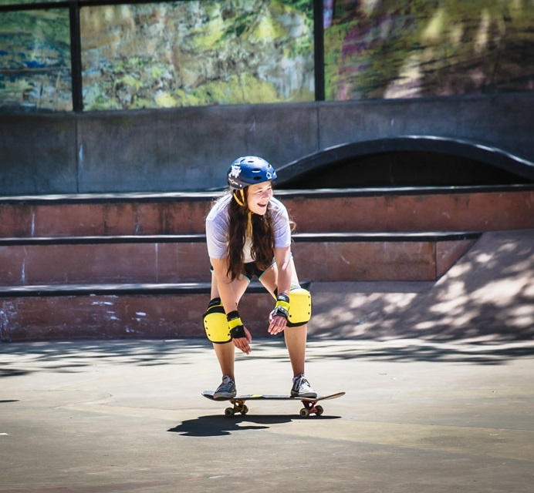
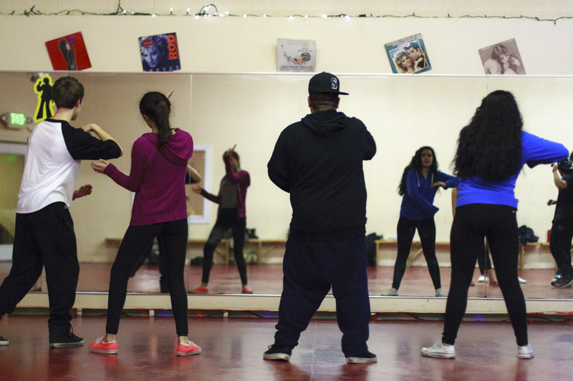
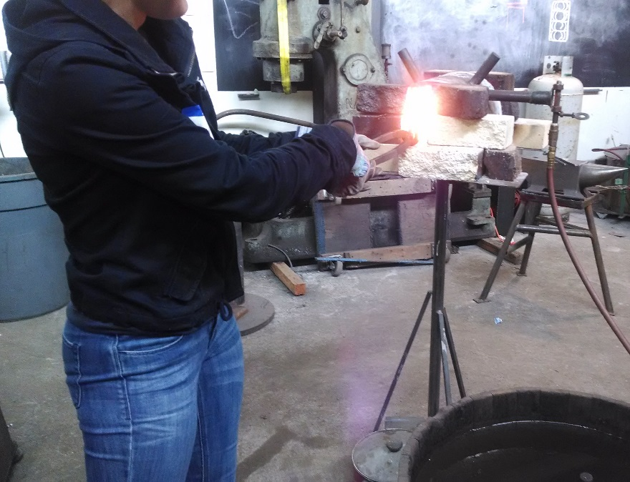
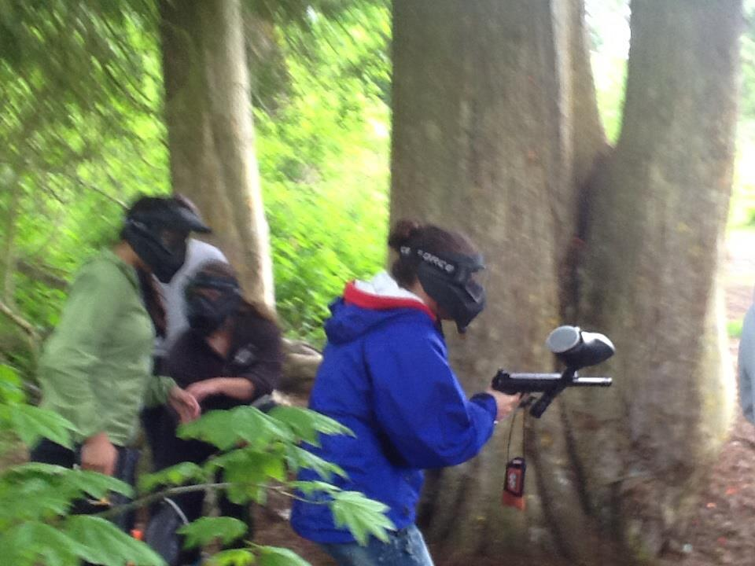
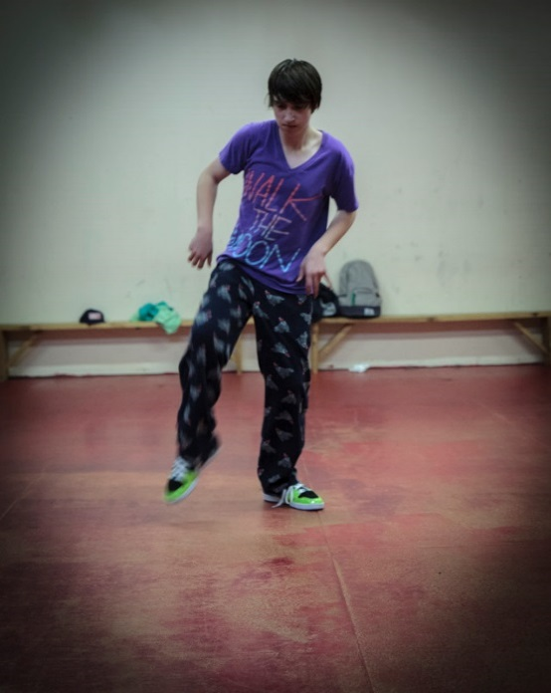
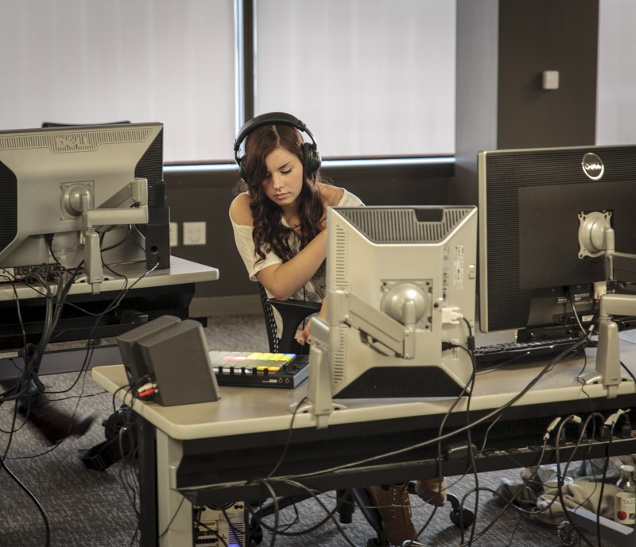
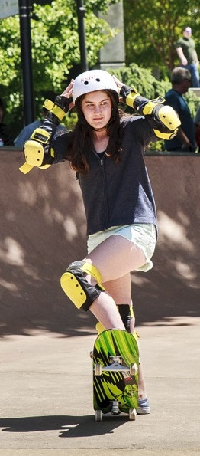
Our programs
Notes:
Creative arts, gender, student-led projects, active and passive,

Slide 7
Major findings
Students would like more genuine and informal interactions with adults
There is a disconnect between actual and perceived choices
Notes:
Who do you talk to about your goals? A shocking number said no one or friends; Disconnect…girls talking themselves out of things; boys being much more willing to pick from a wider array and then more tunnel-visioned; girls tend to be more near-sighted.
Lisa first point, Tom second point
Perception so limited in scope, but actually they could do just about anything. Before even thinking about them ,kids are ruling out huge numbers of paths

Slide 8

Girls were disappearing from the crowd
Often due to a lack of other girls
Social pressures
Familial and gender pressure - “I’m not going to be good at it.”
“This is not for me.” Imagination almost working against them.
Notes:
The ID Tech camp; social pressures…mean girls and ex-boyfriends, girls much more socially aware, seemed more affected by it general; girls would tell us they were interested in things but feeling like those things weren’t this is not for me…girls who have an interest but don’t envision themselves in professional roles

Slide 9
Perceptions of future choice
Even within careers, scope of perception is narrow
Girls don’t envision females in game design and therefore they can’t envision themselves in game design
Research suggests perception is key to pursuit
Notes:
Second bullet…Megan and Jill…what would I do with math? Teach it? Be a mathematician; Both sexes struggled to envision themselves in a variety of roles, but girls in particular seemed to really limit themselves. For instance, we had multiple instances where boys would talk about being pro sports players, rappers, entrepreneurs, game designers, doctors, and mechanics (sometimes even the same boys). The girls not only imagined themselves in more traditional female roles, they often talked themselves out of their answers as they gave them (“I would be interested in doing photography, but that is not a reasonable way to make a living.” Girls would also drop out of complete interest areas due to peer pressures, ex-boyfriends being in groups or other mean girls. Boys rarely mentioned instances of leaving whole interest areas due to purely social reasons. May be that girls are just more apt to talk about it? However they were unprompted responses.

Slide 10
Imaginative Education
“Imagination is the ‘reaching out’ feature of the mind, enabling us to go beyond what we have mastered so far.”
Notes:
As we know, imaginative education engages learners in thinking of possibilities, lifting some constraints. Even outside of a classroom setting, or in terms of looking at opportunities to spread creative ideas and ways of thinking about learning, we see a real synchrony in what we do, we jive with it, unicorns and butterflies, bob marley and drum circles.

Slide 11
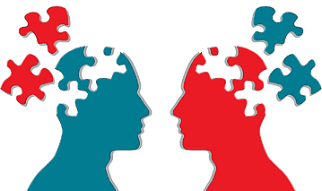
Elements of Romantic Understanding
Fascination with extremes
Jigsaw of ideas
Learning that looks different, not just a lecture
Human emotions and understanding
Notes:
Bullet 3: Lilianna quote about Ted Talks

Slide 12
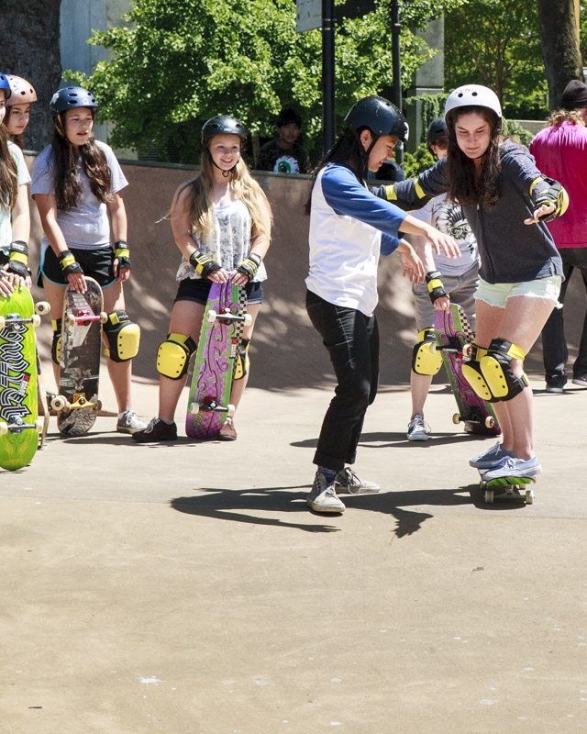
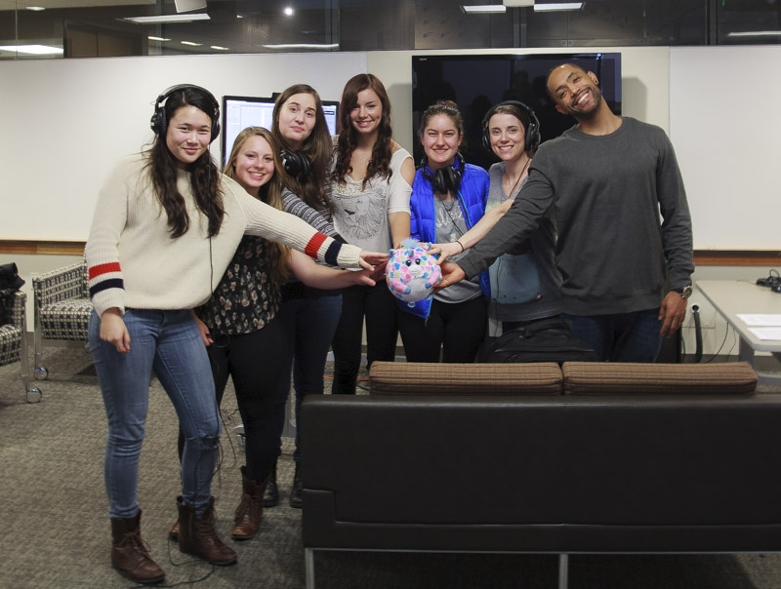
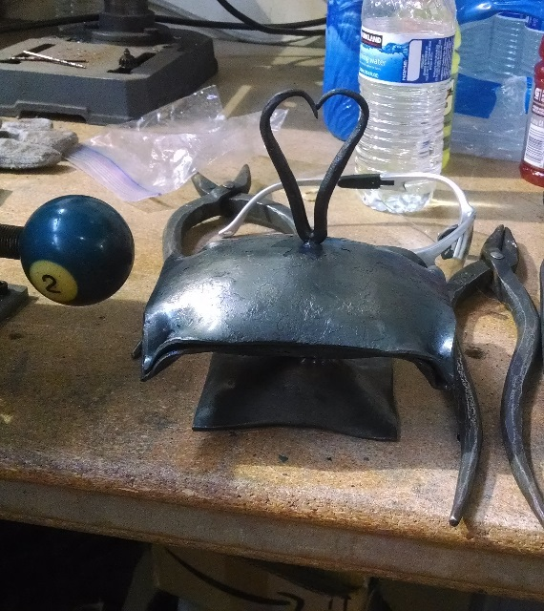
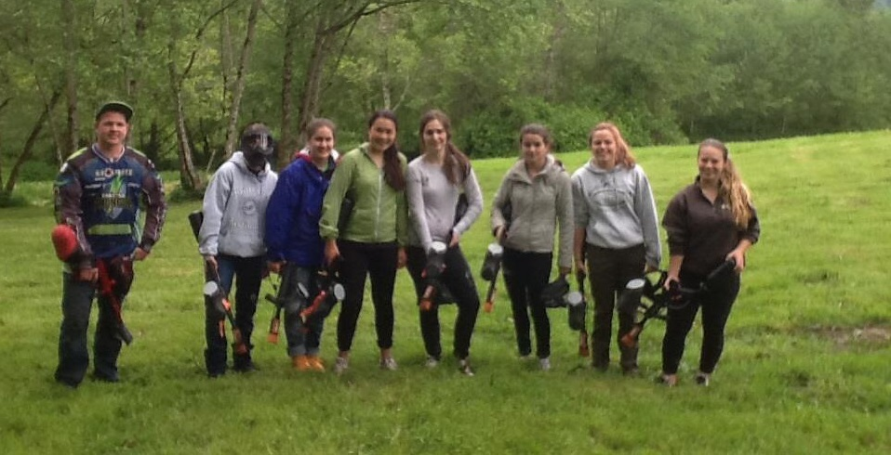
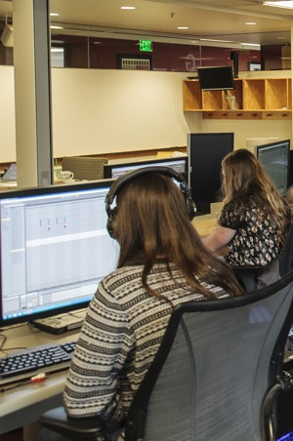
In particular, the Girls’ Group
Notes:
The idea was based on the research we had done. We wanted to get girls to imagine themselves doing a broader array of things. To get them to think about trying new things that they would have self-inhibited from due to pre-conceived notions.

Slide 13
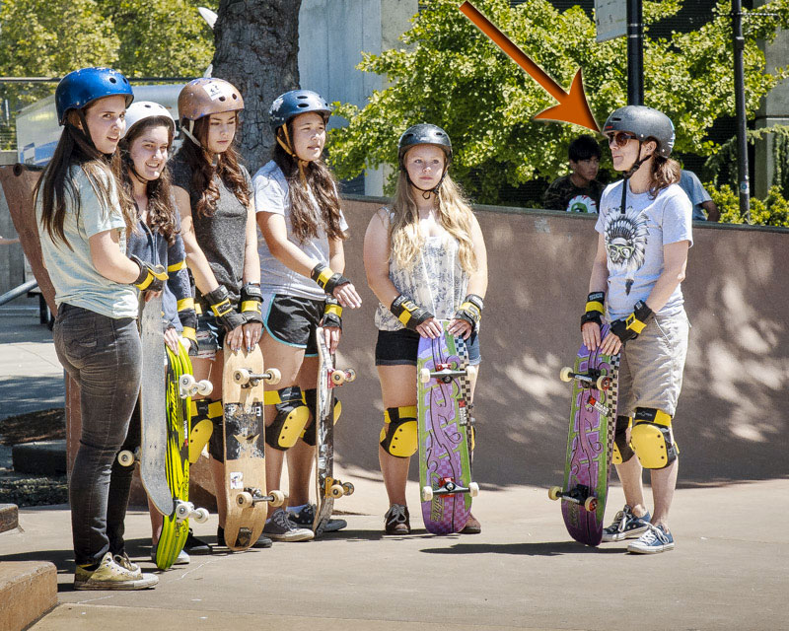
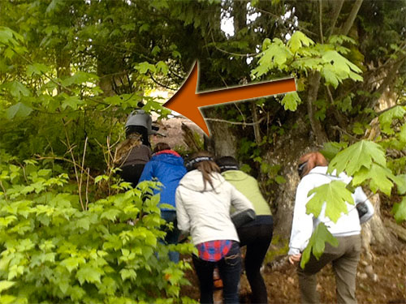
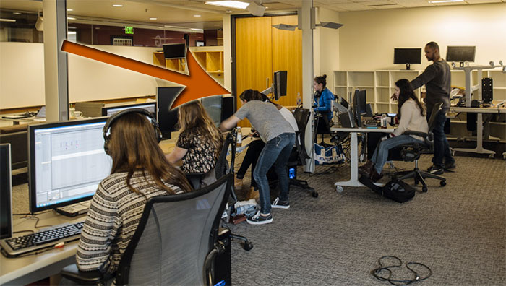
How it started
Five girls
Existing relationships were key
Lisa participated in all events
Gathered non-invasive qualitative data

Slide 14

Girls’ Group Goals
Opportunity to try new things
Passive vs. active
Monitor evolution of ideas
Perception of learning
Notes:
The idea began to emerge for this group after a few structured interviews with teenage boys. Several of them expressed interest in gaming, game design, programming or film. Nearly all had taken some sort of class, outside of school, in one of those subjects and when asked, expressed that very few females were present. Even prior to actually interviewing teenage girls, it was becoming increasingly evident that they were going to be drawn to different experiences than the boys.

Slide 15
Fascination with extremes
Modern-day media as well as books draw these out
Skateboarding what they imagined from the movies/tv
Digital Music what they pictured from real DJ’s; EDM
Metalwork what they envisioned from pictures/reading
Notes:
Many of the outings we took the girls on were designed to give them a glimpse of things they considered pretty risky/extreme or perhaps “not them” but things of interest that they had clearly imagined themselves doing

Slide 16
Piecing together understanding
Finding connections to past experience
“Would my experience in song-writing help me in digital music?”
“I was extremely scared during snowboarding. Will skate-boarding be similarly scary?”
“I do a variety of dance styles, but not hip-hop. How will it be different? Will it help that I have done other types of dance?”
Notes:
Pg 87 in Kieran’s book…looking at a jigsaw or holographic approach to understanding: “It is just entertainment, not important learning” – Liliana quote about ted talk

Slide 17
Human Emotions and Understanding
The events have elicited a variety of emotions
In experiencing them with a small group of the same girls, the opportunities to share these emotions, particularly in the car on the way to and back from events is key.
Understanding what it is like to be a “creator of song”, experience the power of “bending metal”, being “warriors” on the paintball field, “expressing my ideas as a painter”, getting to be a “skater girl”
Notes:
Kieran talks about how human beings have created our knowledge and through these experiences they have had a unique opportunity to look through the lenses of other creators to see and experience this knowledge first-hand.

Slide 18

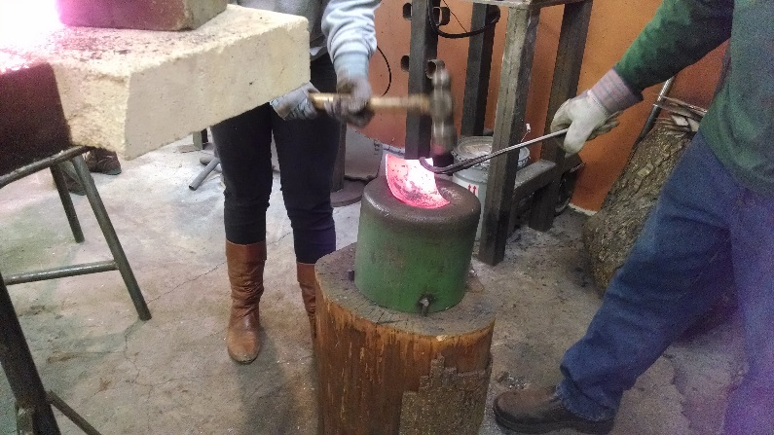
Metal Shop: Pre-Event
Nearly all the girls gave a low score for how likely they would be to ever try this
There was a wide-range in terms of how comfortable they felt about participating
Self-deprecation in answers:
“Oh, dear, I’m just so great at answering these.”

Slide 19
Metal Shop: Pre-Event
"By doing something unusual that I might not have tried on my own before, could spark an interest in other activities that are different from the extra-curriculars I already do."
“I bet I'll figure out how to face fears about hurting myself and probably realize that some things that I think are really scary, isn't actually all that bad.”
Notes:
When we arranged this event, we talked to the folks about what would be appealing for girls to do; we tried to pick things to make that would appeal to girls in terms of getting to add some artistry; creating an artistic vision. “How do I compare to the other girls in terms of skill?”

Slide 20

Metal Shop: Post-Event
“I really liked working with heat…that sounds weird.”
“I was okay being around hot flames; I didn’t die.”
"I thought I would be more scared, but as I kept working, I became way more comfortable and it didn't seem as dangerous. I guess I learned that I can calm down and be reasonable while doing something that initially scared me."
Notes:
The importance of the hammer; new appreciation for the work that went into it; the wonder of bending metal; elements of perfectionism…recognized by both individuals and the group

Slide 21
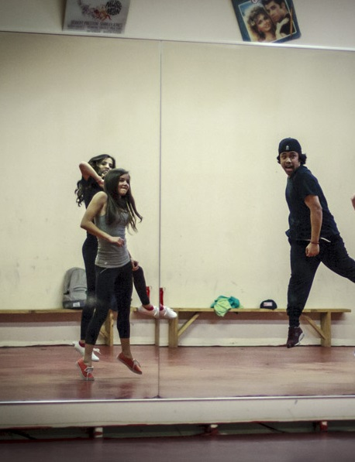
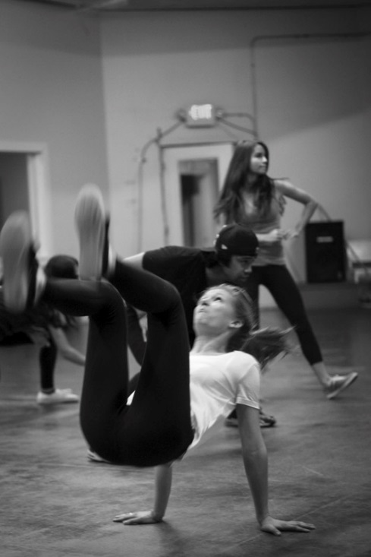
Hip-Hop Dance Class: Pre-Event
Lots of negativity in terms of skill
“Probably that I suck at hip-hop as much as I think I do.”
Familial pressure
“My family would be surprised I am trying this, cause I am not very skilled at it.”
Perceptions of the other girls
“The other girls will be bomb at dancing.”
Notes:
The irony was that I had taught many of them dance and had seen them dance and perform; going to an actual studio with a professional dancer was a whole nother level. Yet, at the same time, there was a lot of excitement
Will I be good at it? I’ve always wanted to try it. I don’t know what to expect?
The isolated nature of hip-hop, even the girls who did dance did not expect their skills to transfer over.
“I will probably be bad at it, but oh well.”
“I am not a good dancer, so it will be interesting to see if I like it or not.”
“They would be surprised. They don’t think I can dance. I’ll show them.”

Slide 22
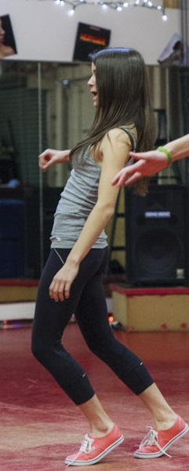
Hip-Hop Dance: Post-Event
Informal conversation after class
Excitement that everyone put themselves out there
Enjoyed opportunity to be in a studio and be “sassy”
Perceived other girls being “so good at dancing”
Referenced concrete skills and bravery for trying it
Notes:
Just made me pause and think about how many times students want to have informal conversations and how much can be gleaned when they occur; the concrete skills and bravery thing is a common theme throughout the events. “I used to be a little scared, but now I love it!”
“I loved it and I’m actually not awful at it!”
“Dance is easier when you are enjoying it.”
“I thought I was going to be really awful at this, but I that bad and it was really fun.”

Slide 23
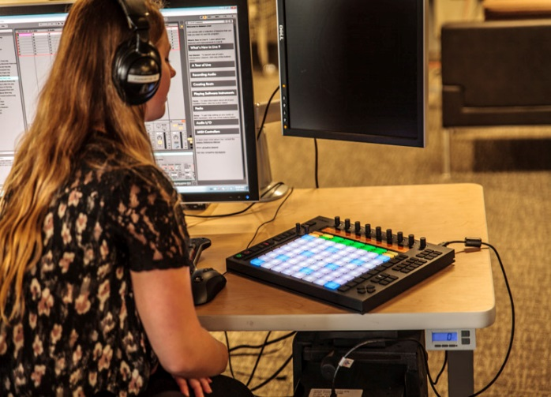
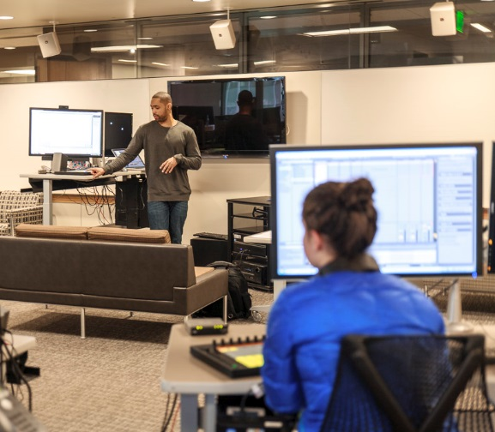
Music Production: Pre-Event
Excited to explore a new genre or way of making music
Wary of technological skill
Difference between hearing digital music and making it
Sharing in a different way; “be creatively brave”
Notes:
Nearly all the girls expressed enthusiasm for exploring music in a different way; some wondered about how similar this would be to other experiences they have had with music or instruments; less physical than the others, some regarded making music as “passive” which is interesting considering they are creating in an artistic fashion; Liliana and her worries;
Girls don’t want their creativity called into question because they were having trouble with the technology
More passive than the other events “Like metal-shop, I feel like this one is going to be different than I anticipate” Downplaying and concerns about technology were major themes What constitutes a creative endeavor?

Slide 24
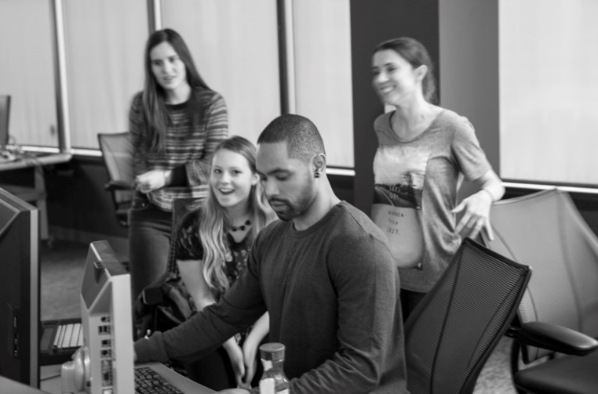
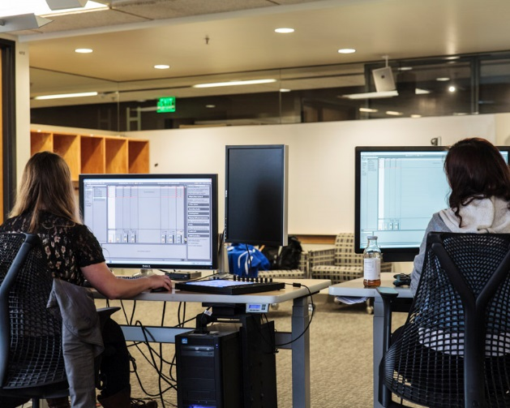
Music Production: Post-Events
Despite lack of technological skill, was fun and I did it
Fascination with tech. and appreciation for art form
Interest in types of music the other girls are making
Noting perceived creativity of the rest of the group
Notes:
Both individually and as a group they felt non-tech savvy; finding out about the girls’ musical interests; the perceived creativity of the group…the buy-in of the girls in terms of their creativity and the relative levels of creativity

Slide 25
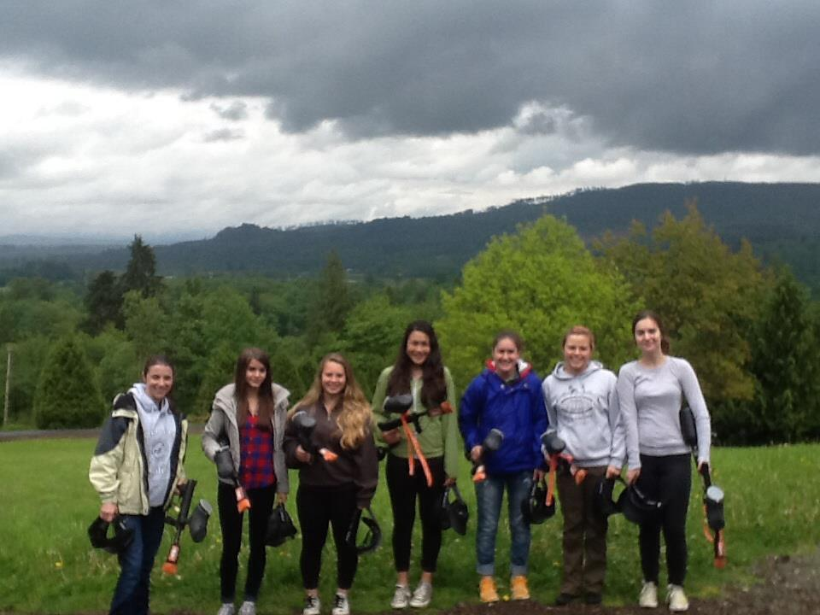
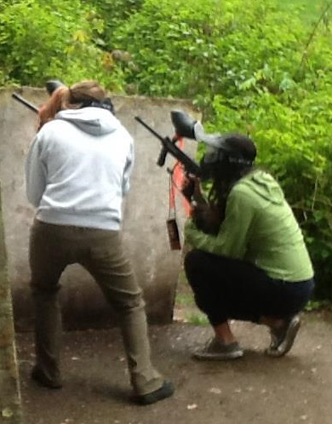
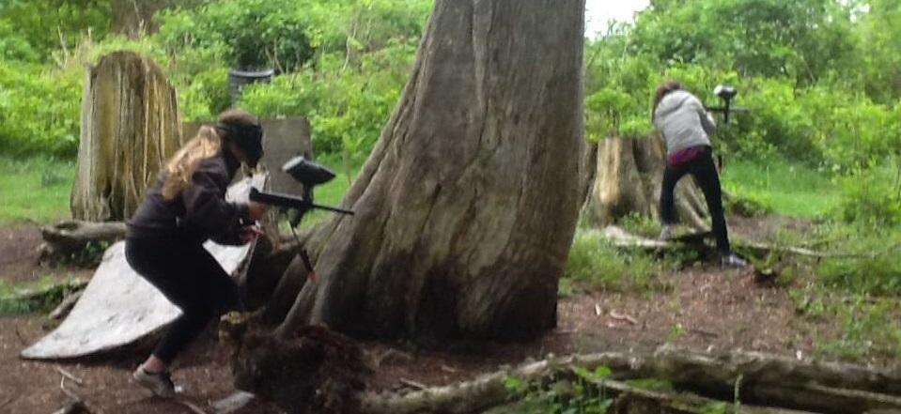
Paintball: pre-event
A great deal of fear
Physical inadequacy
Excitement for the competitive aspects
“Let’s do this.”
Notes:
Bringing in the expert dude
Added two additional girls for even teams
Two adults present

Slide 26
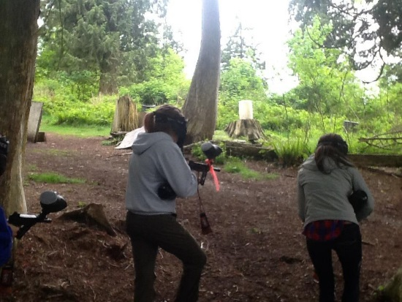
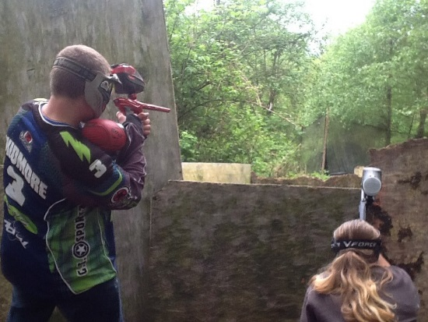
Paintball: Post-Event
Tenacity of girls within group and competitive spirit
Consideration of people who use guns in their line of work
Social concern for other girls, yet willingness to fight as a team
Importance of getting hit
Group dynamics
Notes:
The hand injury and overcoming; the instructor as the enemy

Slide 27
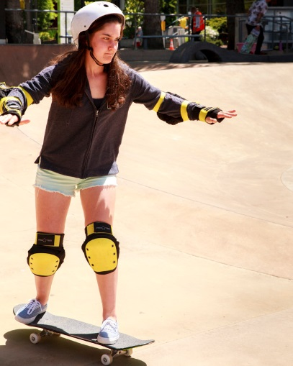
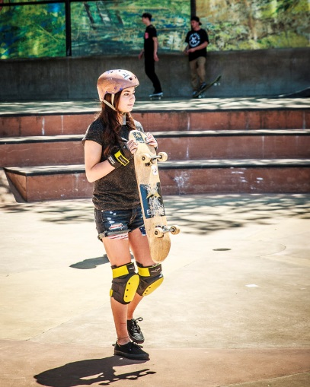
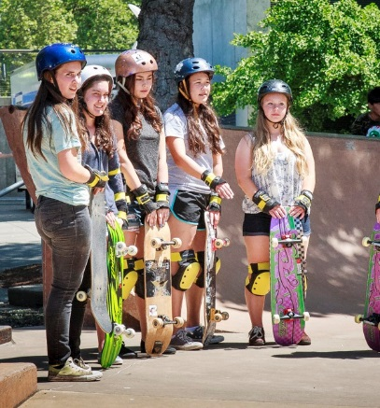
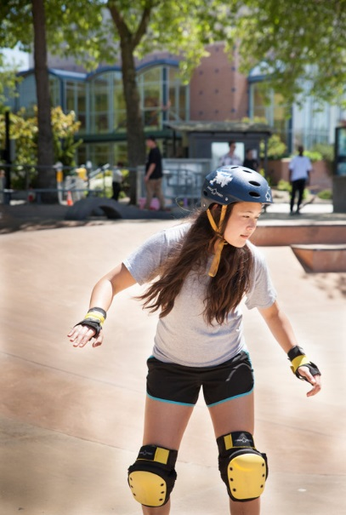
Skateboarding
Cultural Capital– the “coolness” enhanced the excitement
Transfer of skills
More stereotypically male
More public venue – skills on display
Downplaying ability, “Hopefully I can stand up.”
Notes:
A lot more exposure to this at their age-group; I got injured skateboarding and am worried a similar thing will happen; not wanting to look stupid in public; laughing off the fear “ha, ha”

Slide 28
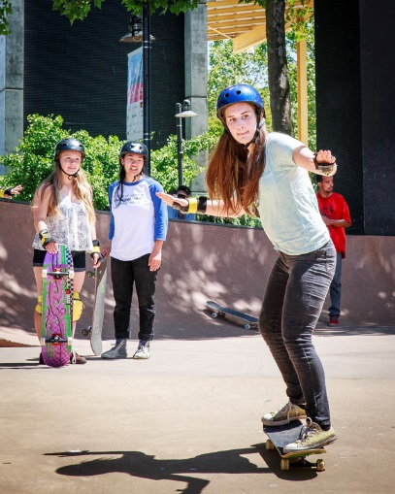
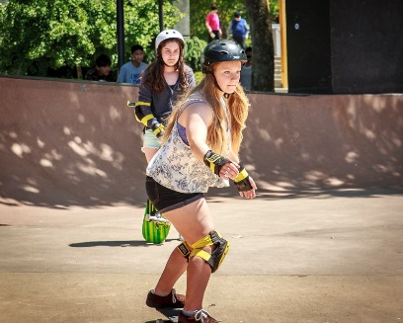
Skateboarding: Post Event
We did “way better” as a group than we thought we would
The hill
Gained “new confidence”
“We were the only girls.”
Notes:
Often post-events result in a more social in-nature reflection perhaps due to the group bonding experience; strong gender based social pressure; age pressure; and being in front of a different group; team encouragement

Slide 29
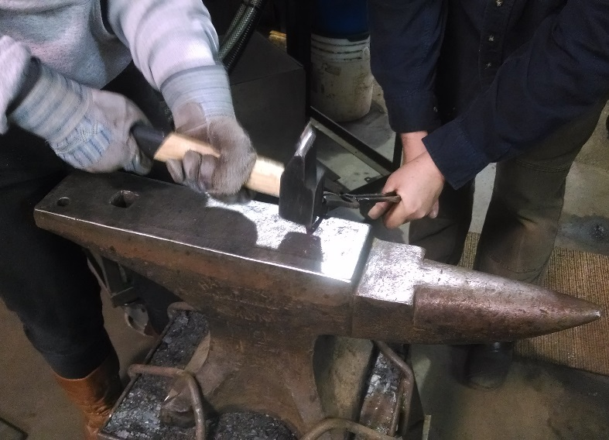
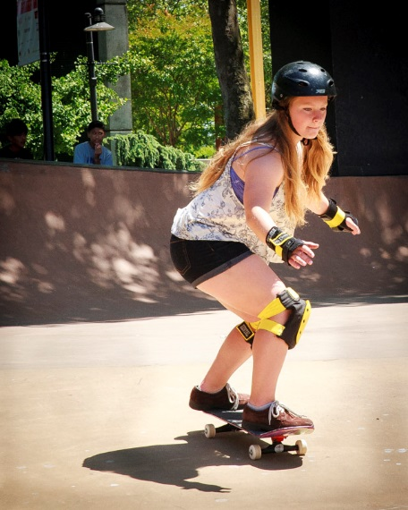
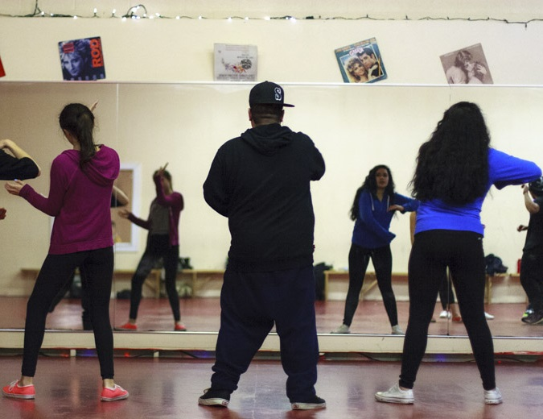
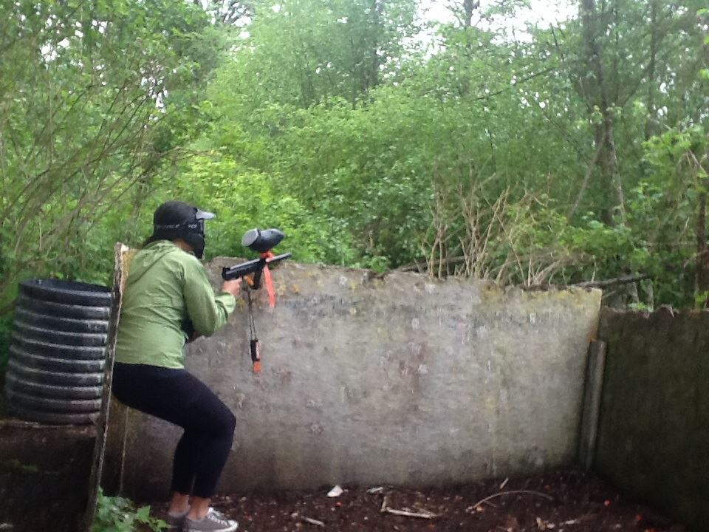
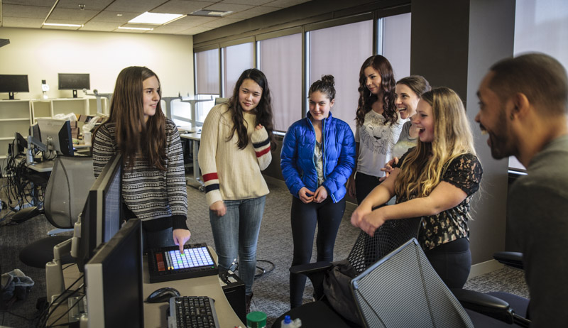
The pivotal moments:
Notes:
Metal shop--- hammer and super hot fire; Dance --; Paintball – getting shot
This is the point that feeds their imagination, and will be remembered about the event

Slide 30
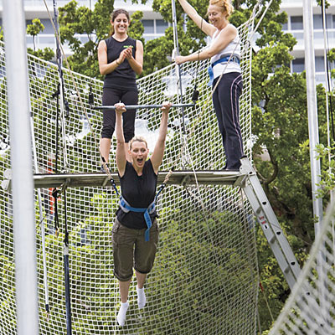
Next steps for Girls’ Groups
Visual Arts
Trapeze Class
Final participant interviews
Parental interviews
Longitudinal follow-up of the girls
Re-running the group

Slide 31
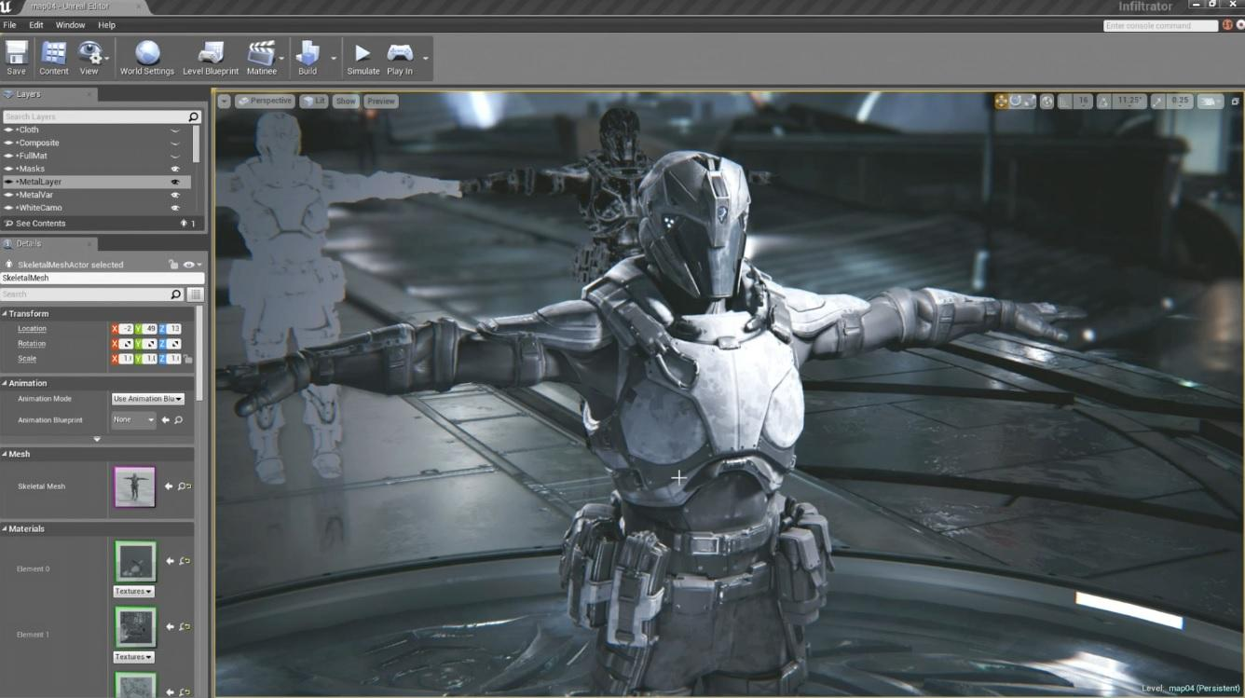
Student-led internships
What am I interested in and how can I pursue it?
Is reality anything like what I had imagined?
Knowledge extremes
If they can conceptualize it, we want to support it
Notes:
Talk about the perceptions of choice; LIDS
They get to see all the things that go into their ideal “career”,

Slide 32



The groups
Video game design
and development
Cinematography and documentary creation
Visual and musical art gallery
Notes:
Mentors, team leaders, experts; novice vs. expert learning; student voice….getting focused time with adults who can listen to their concerns and ideas

Slide 33
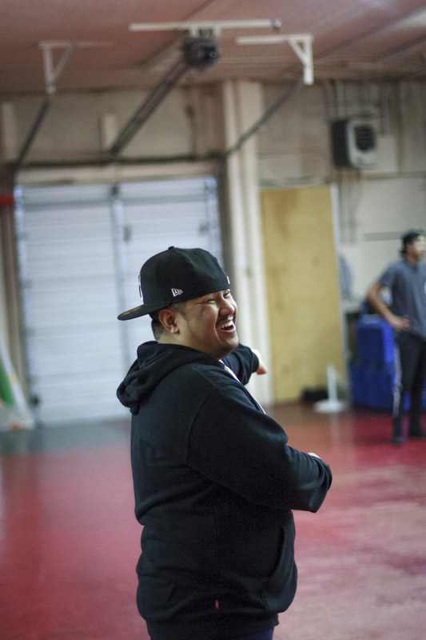
Hip Hop
Perception of choice in free-style dancing
Freedom of movement, freedom of mind
What choices surround personal artistic expression?
Seeing extremes in styles helps kids to connect with their own
Notes:
When the kids get to see these extremes in different styles, it helps them to find where their comfort zone is and where they want to go. They can imagine what kind of dancer they want to be. What happens when dance is not just about following the leader

Slide 34
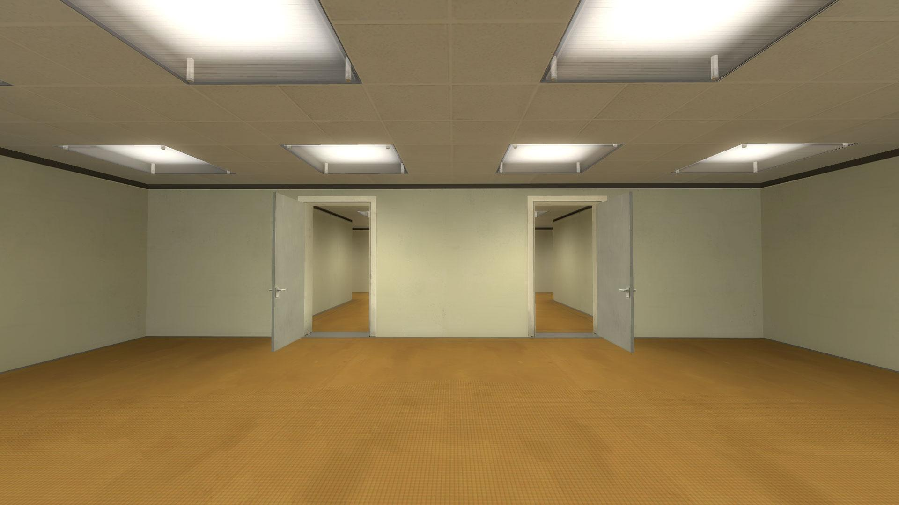
Research in creativity and choice in gaming
Stanley Parable choice-based narrative game
Initial studies suggest gender-based differences in how their choices are percieved
Notes:
One of the things that we believe is that playing video games helps kids to foster and grow their imaginations, and solve problems creatively. When we started to see these trends emerging in boys and girls, we wanted to see experimentally if the same held true in games. One of our studies focuses on how participants make choices within games.

Slide 35

Imagining the future
Notes:
Foundry10 is a place where things get done, things get made, and people are doing. There are a lot of people that are just writing and discussing research, but we wanted to get out there and see what happens. How can we challenge imagination?
If you have cool ideas or would be interested in trying one of the groups we have run, come to Lisa who has all the “ideas” not Tom who does all the work of setting everything up. If you need help with having your idea taken over, come to Lisa, if you want someone to help find mentors, plan dates, organize kids, prepare curriculum
Share and vary group models

Slide 36
Contact info
http://foundry10.org
@foundry10ed
Lisa Castaneda
Lisa@foundry10.org
Tom Swanson
Tom@foundry10.org
Notes:
If you have cool ideas or would be interested in trying one of the groups we have run, come to Lisa who has all the “ideas” not Tom who does all the work of setting everything up. If you need help with having your idea taken over, come to Lisa, if you want someone to help find mentors, plan dates, organize kids, prepare curriculum

